Slide 2
What is a Model?
Models are often built in the context of business and IT systems in order to better understand existing or future systems.
However, a model never fully corresponds to reality.
Modeling always means emphasizing and omitting: emphasizing essential details and omitting irrelevant ones.

Slide 3
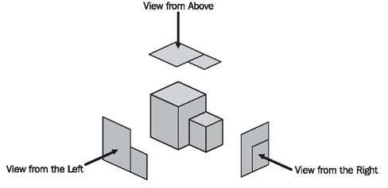
Views
The more information a model gives, the more complex and difficult it becomes.
A map of Europe, for example, that simultaneously contains political, geological, demographic, and transportation-related information is hardly legible. The solution to this problem is to convey the different types of information on individual maps.
Different views are formed of the objects. These views are interconnected in many ways.

Slide 4
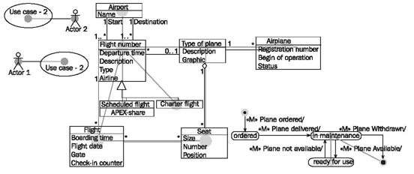
Diagrams as Views
Each particular UML diagram corresponds to one view of a model of a system.

Slide 5
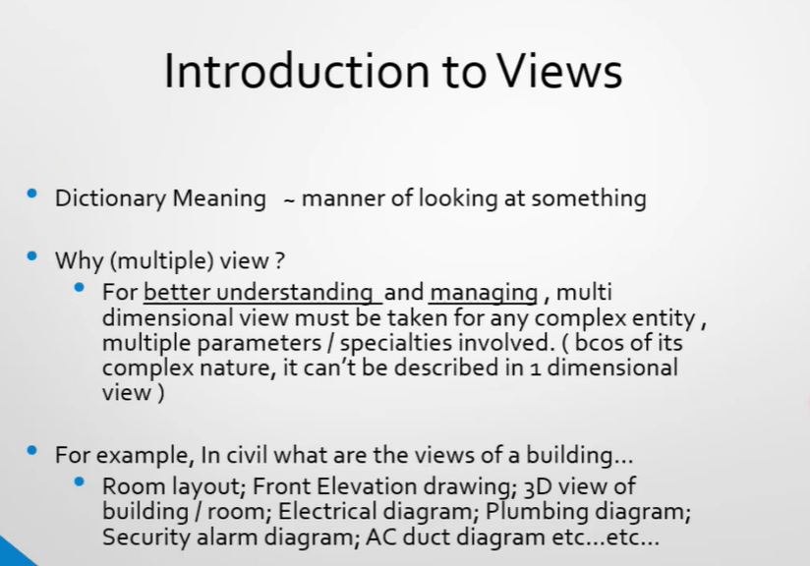

Slide 6
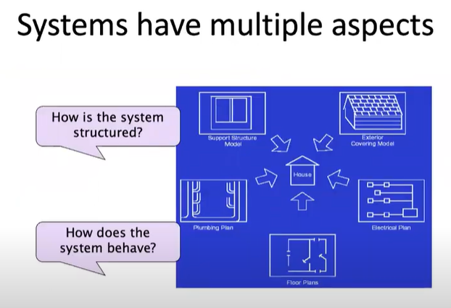

Slide 7
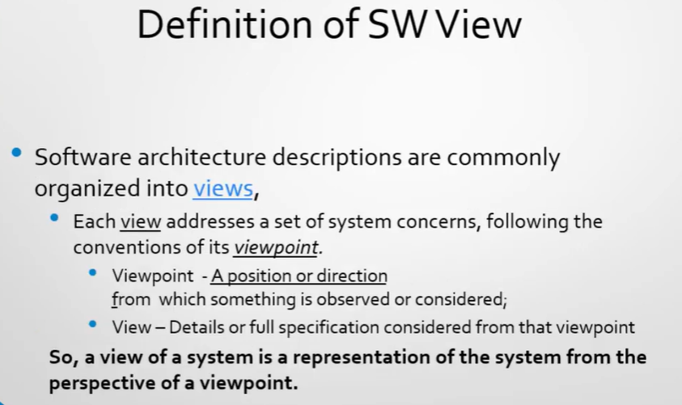

Slide 8

But why????
Different stakeholders always have different interest in a software system

Slide 9
4+1 view model
It was introduced by Philippe Kruchten in 1995
The views are used to describe the system from the viewpoint of different stakeholders , such as end users , developers and project managers

Slide 10
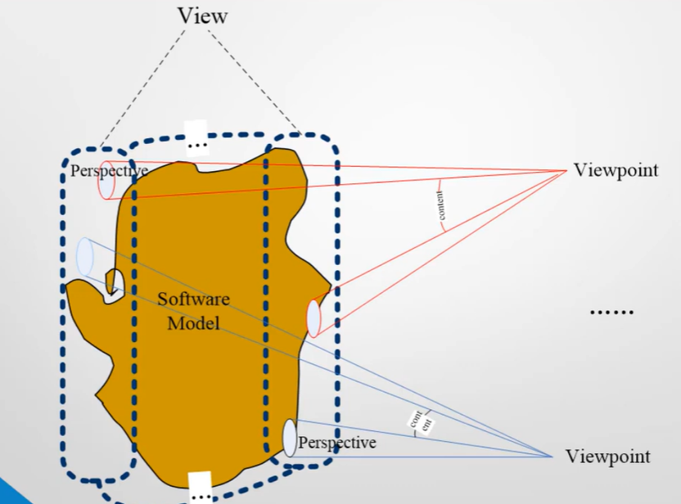

Slide 11
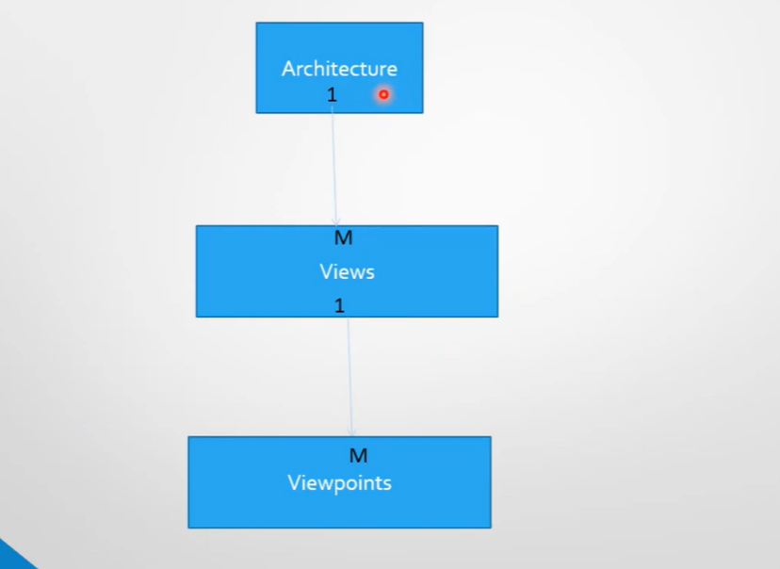

Slide 12
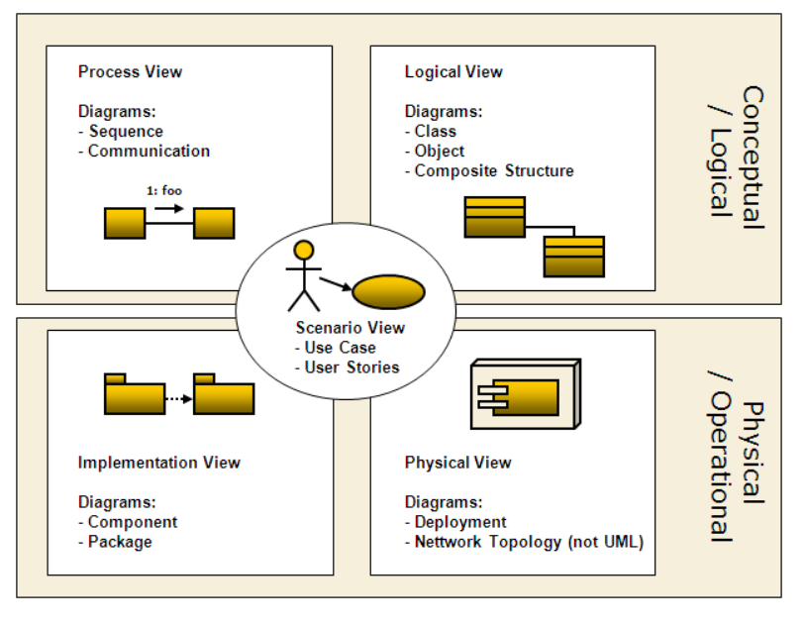

Slide 13
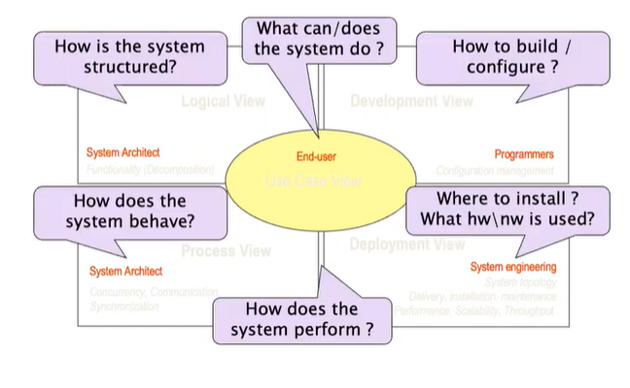

Slide 14
The Logical View/Structural view
(Object-Oriented Decomposition)
The system is decomposed into a set of key abstractions, taken (mostly) from the problem domain, in the form of objects or object classes.
Viewer / Stake holder: End user , Analyst , Designer
Considers: supports the functional requirements—what the system should provide in terms of services to its users.
UML diagrams: Class, State, Object, sequence, Communication Diagram

Slide 15
The Process View/ Behavior view
(Process Decomposition)
A process is a grouping of tasks that form an executable unit.
Shows how , at runtime , the system is composed of interacting objects
Shows the processes and how they communicate with each other
Considers : The process view takes into account some non-functional requirements,
such as performance and availability. It addresses issues of concurrency and distribution, of system’s integrity, of fault-tolerance, and how the main abstractions from the logical view fit within the process architecture—on which thread of control is an operation for an object actually executed.

Slide 16
The Process View
Viewer / Stake holder: Integrators & developers
UML diagrams: Activity Diagram

Slide 17
The Development View/ Implementation view
Subsystem decomposition
Shows how the software is decomposed for the development
It gives a building block view of the system
Considers : The development architecture focuses on the actual software module organization on the software development environment. The software is packaged in small chunks—program libraries, or subsystems— that can be developed by one or a small number of developers.
The subsystems are organized in a hierarchy of layers, each layer providing a narrow and well-defined interface to the layers above it.

Slide 18
The Development View
Viewer / Stake holder : Programmer and software project managers
UML diagrams : Component, Package diagram

Slide 19
The Physical View/Deployment view
(Mapping the software to the hardware)
Shows the installation, configuration and deployment of software application
Considers : Nonfunctional requirement regarding to underlying hardware(Topology , communication)
Viewer / Stake holder: System engineer, operators, system administrators and system installers
UML diagram : Deployment diagram

Slide 20
The Physical View
Components are either processing nodes (servers, virtual machines, docker containers, serverless configurations, etc.) or networking channels (routers, firewalls, proxies, load balancers, etc.) and the diagram should illustrate which nodes host which processes from the process view. This allows us to start considering compute and network capacity, as well as latency and other performance considerations.
The view shows the system execution environment

Slide 21
Scenarios
(Putting it all together)
The scenarios are in some sense an abstraction of the most important requirements.
This view is redundant with the other ones (hence the “+1”)
The elements in the four views are shown to work together seamlessly by the use of a small set of important scenarios

Slide 22
Scenarios
Considers : System Consistency and validity
Viewer / Stake holder:All the views of their views and evaluators
UML diagram : Use case diagram

Slide 23
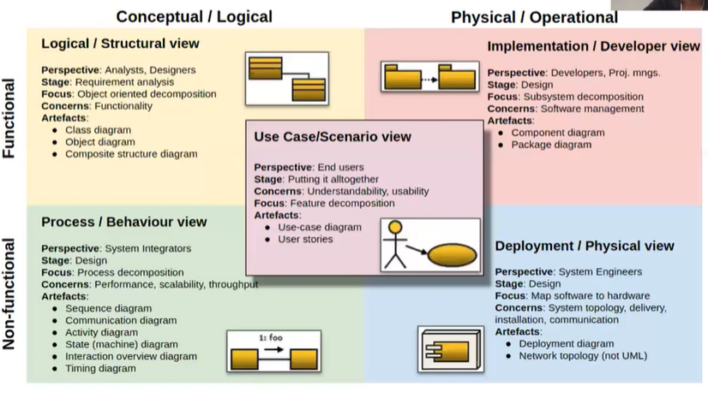

Slide 24
Why is it called 4+1 instead of 5?
The use case view has a special significance as it details the high-level requirement of a system while other views details — how those requirements are realized. When all other four views are completed, it’s effectively redundant. However, all other views would not be possible without it.

Slide 25
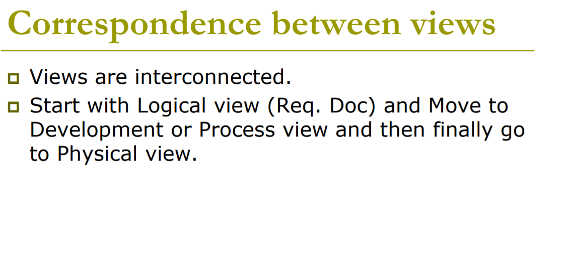

Slide 26
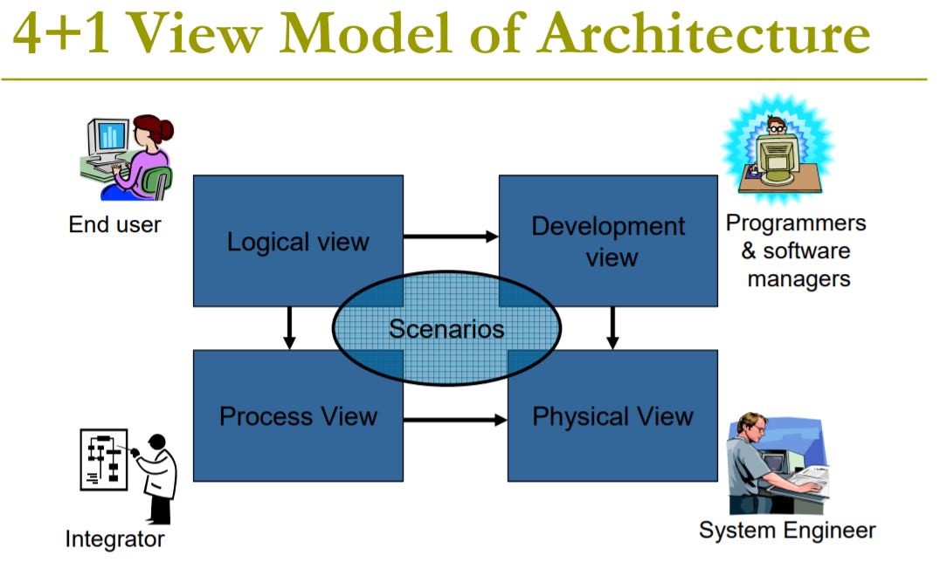

Slide 27
For any given system, you may not need to document all the views, and there may be other, more relevant views for your system.

Slide 28
One Model—Two Views
Viewing a business system from the outside, we take on the role of a customer, a business partner, a supplier, or another business system. From
this external view, only those business processes that involve outsiders are of interest. The external view describes the environment of a business system. The business system itself remains a black box.
Within the business system, we find employees and tools that are responsible for fulfilling the demands of the environment, and for handling the necessary business processes. Behind the business processes are workflows and IT systems. Each individual employee is part of the organizational structure. Normally this internal view remains hidden to outsiders.

Slide 29
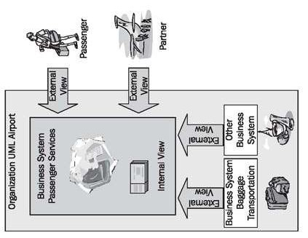
External and Internal view of a business system

